Slide 1

Diamonds Pricing Prediction
Presentation: Niloofar Zarifi
Project Sponsor: Palawat Supharerk
DATA SCIENCE AND APPLICATION
Data Prepared: October 03, 2019

Slide 2

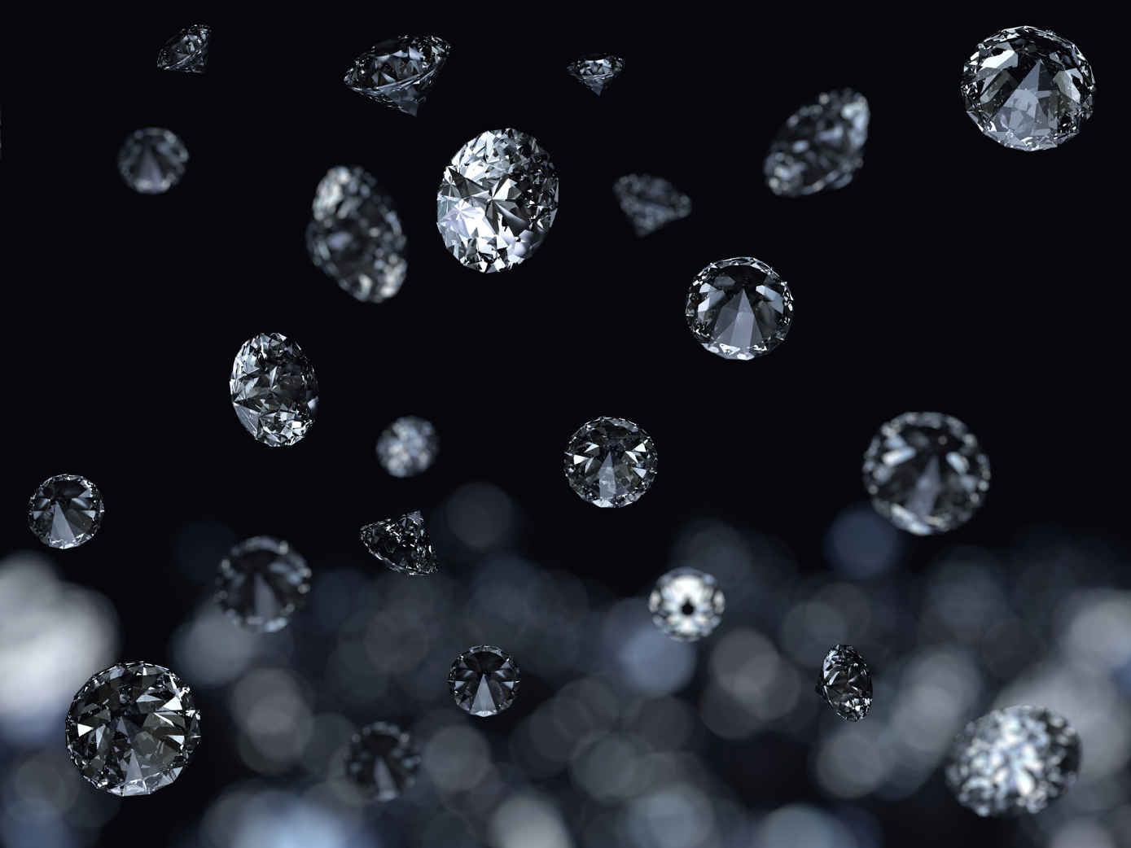
Bidding a Large Set of Diamonds
Introduction to data set
Exploratory Data Analysis
Input Data Relationship
Linear Regression
Conclusion

Slide 3
Data Set Information
Price | price in US dollars ($326--$18,823)
Carat | weight of the diamond (0.2--5.01)
Cut | quality of the cut (Fair, Good, Very Good, Premium, Ideal)
Color | diamond colour, from D (best) to J (worst)
Clarity | measurement of how clear the diamond is (I1 (worst), SI2, SI1, VS2, VS1, VVS2, VVS1, IF (best))
x | length in mm (0--10.74)
y | width in mm (0--58.9)
z | depth in mm (0--31.8)
Depth | total depth percentage = z / mean(x, y) = 2 * z / (x + y) (43--79)
Table | width of top of diamond relative to widest point (43--95)
Original Dataset: 53940 diamonds
3000 diamonds for sell with the following attributes:
1. carat cut
2. cut_ord
3. color
4. clarity
5. clarity_ord

Slide 4
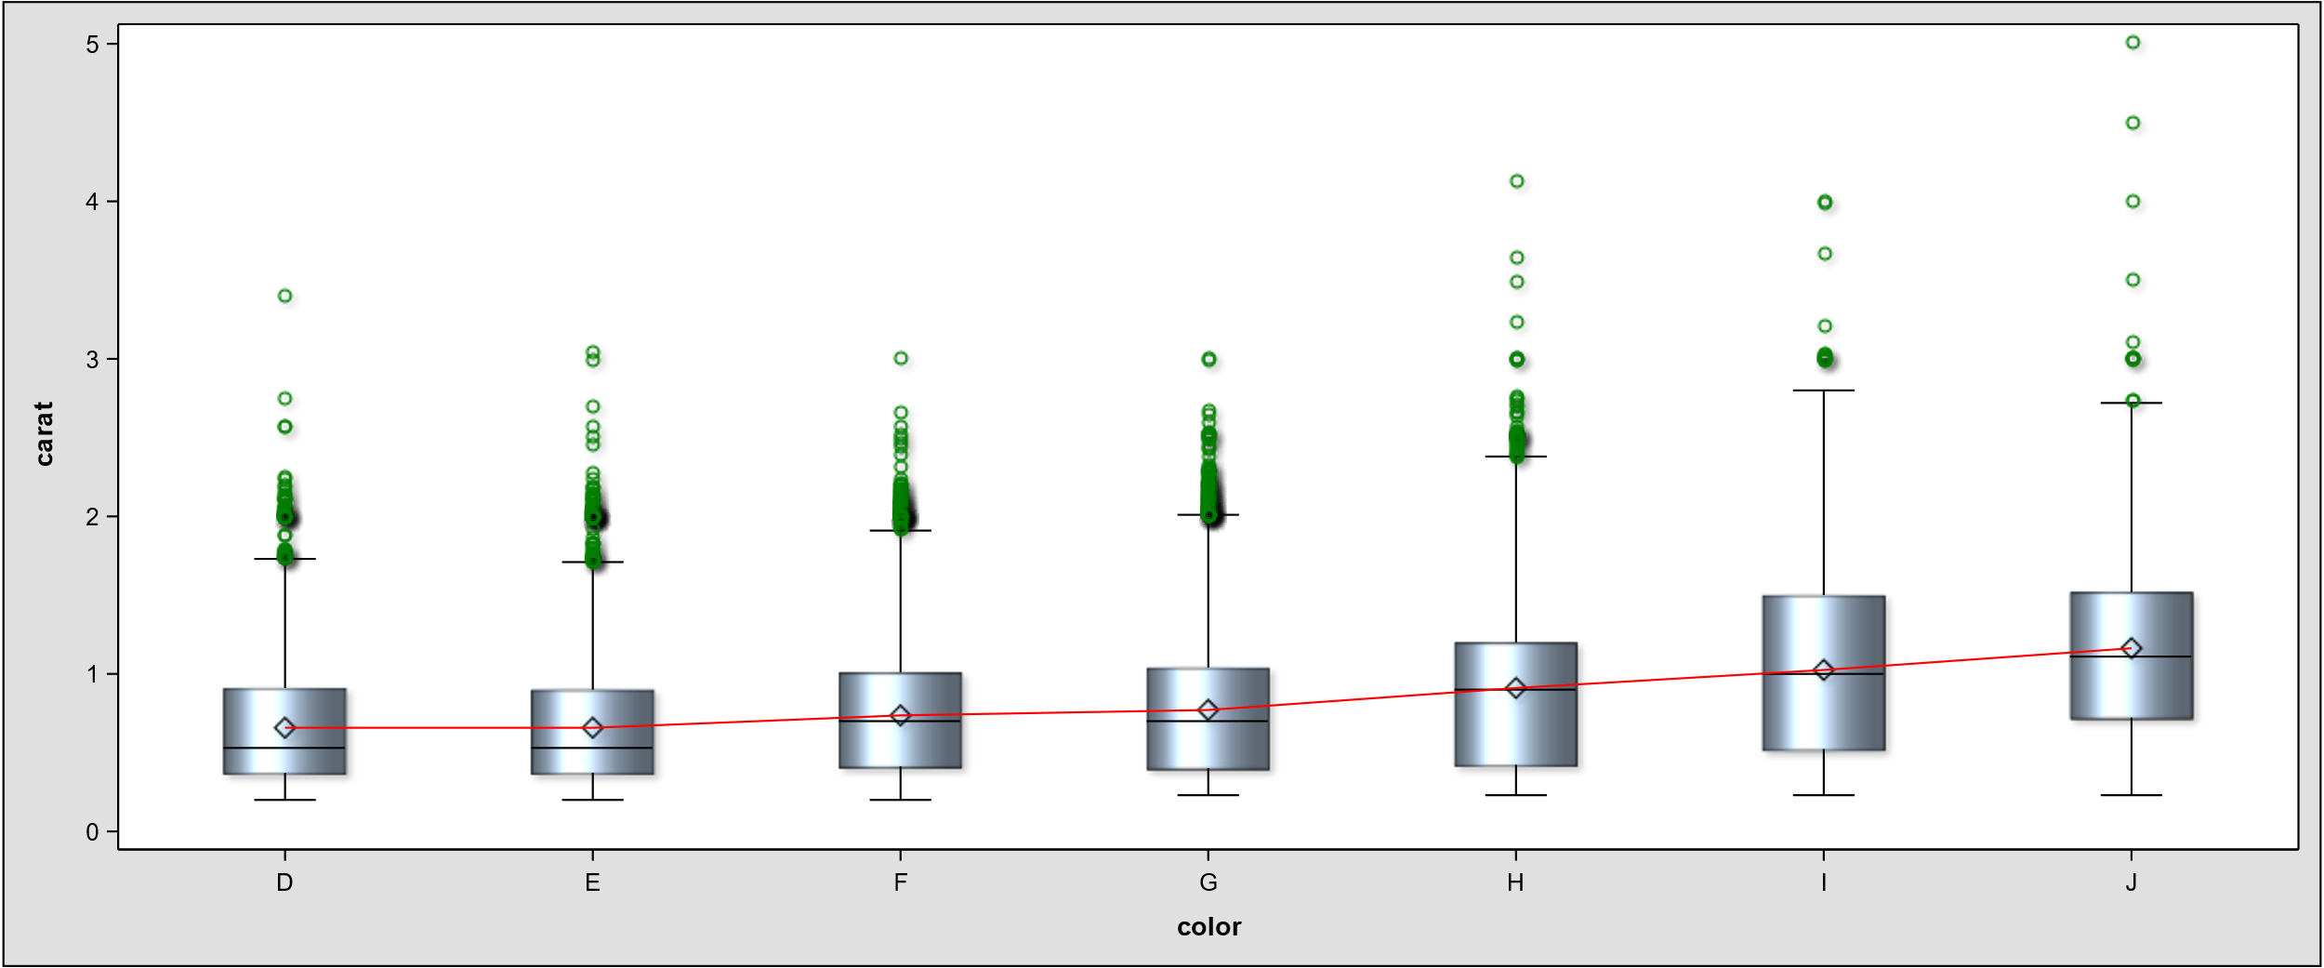
Boxplot Carat and Color
Heavier diamond is more valuable?
D (best color) J (worst color)

Slide 5
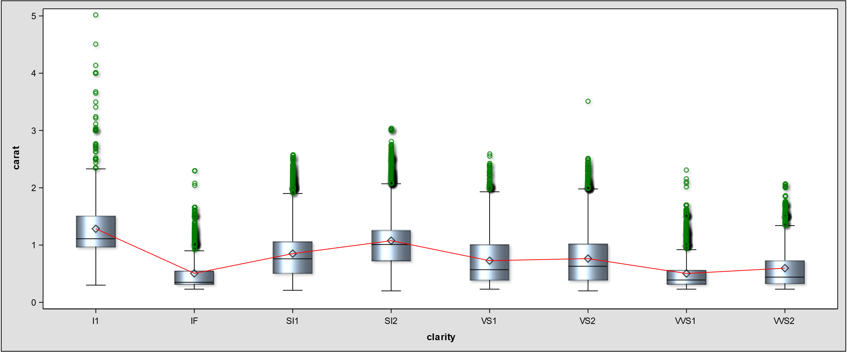
Boxplot Clarity and Color
Better clarity means lighter diamond?
Clarity order: I1 (worst)< SI2< SI1< VS2< VS1< VVS2< VVS1< IF (best)

Slide 6
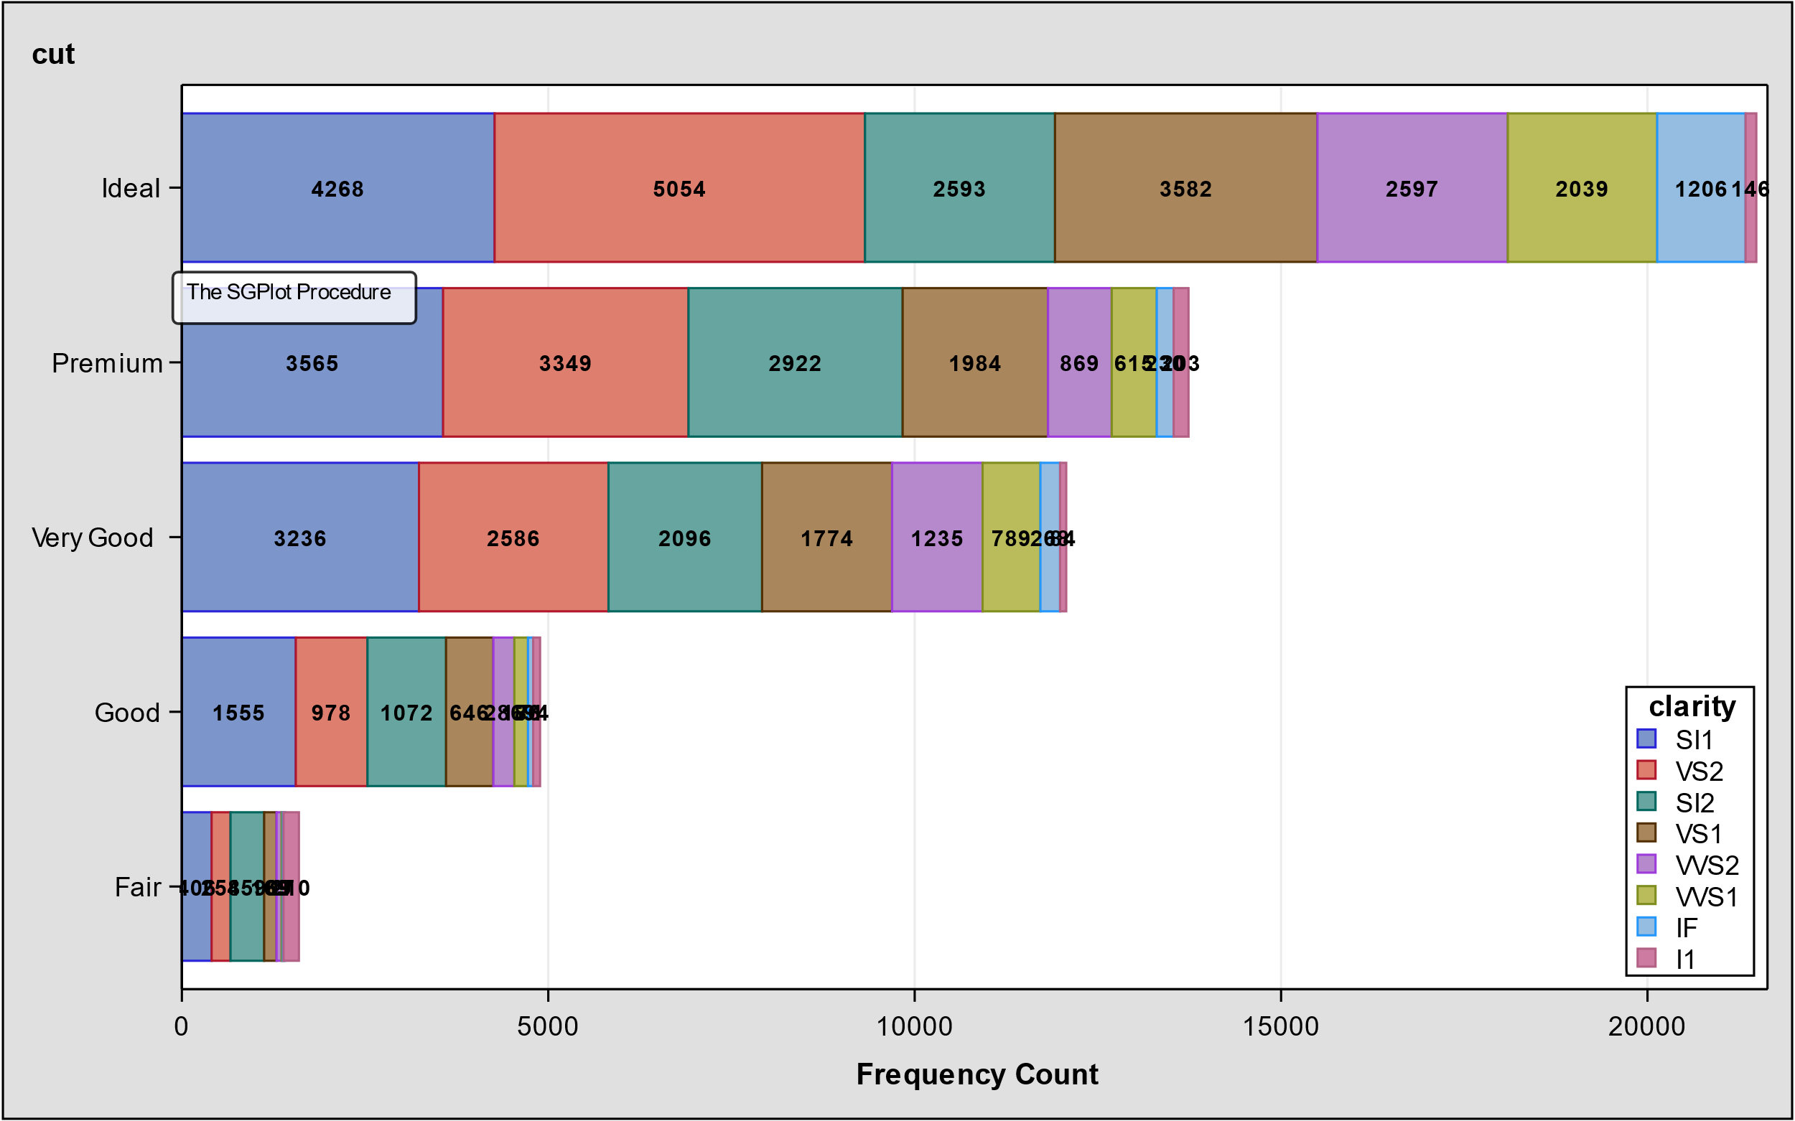
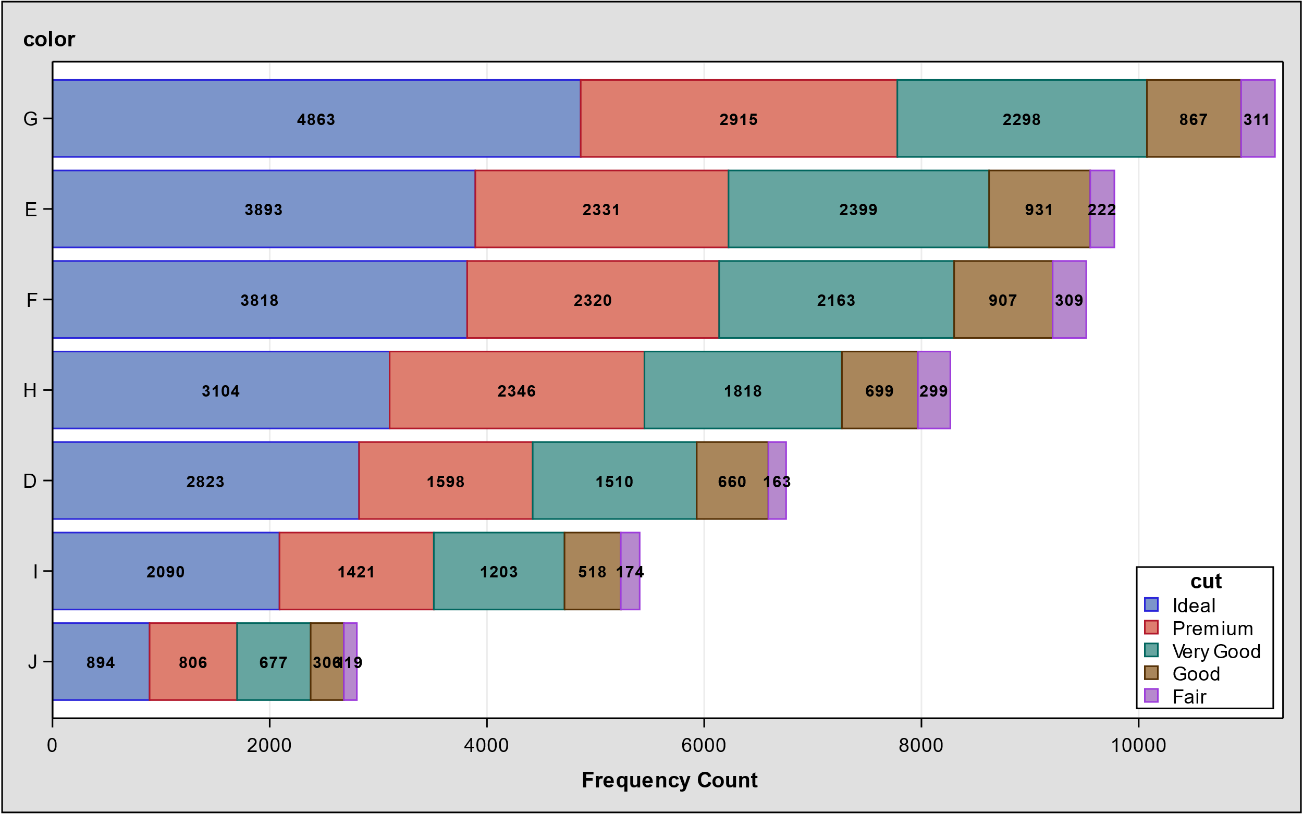
Distribution of Cut and Color
Majority of diamonds have the best cut and medium color
Quality of the cut in order: Fair < Good < Very Good < Premium < Ideal
Quality of the color in order: J < I < H < G < F < E < D

Slide 7
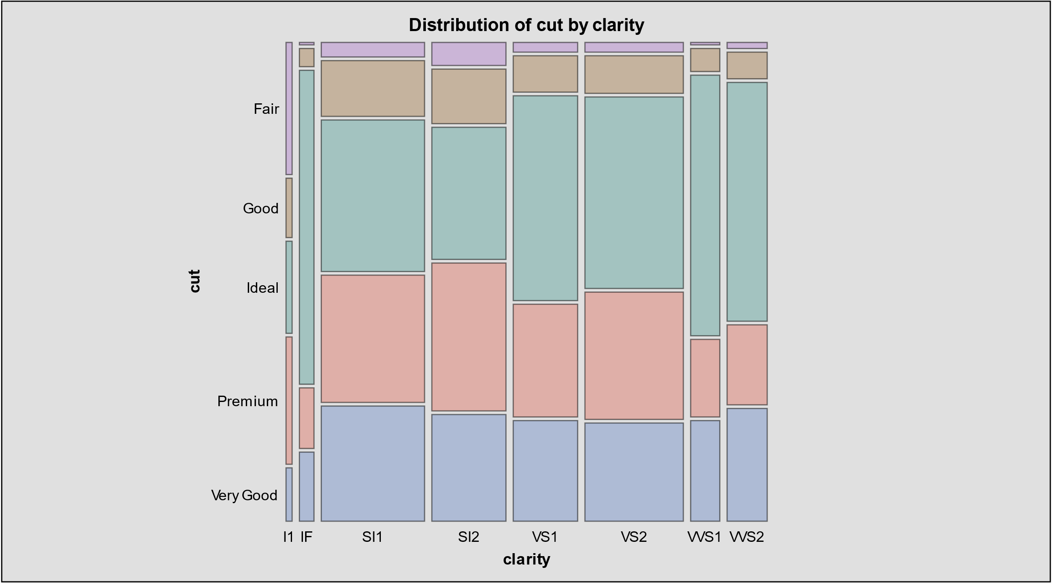
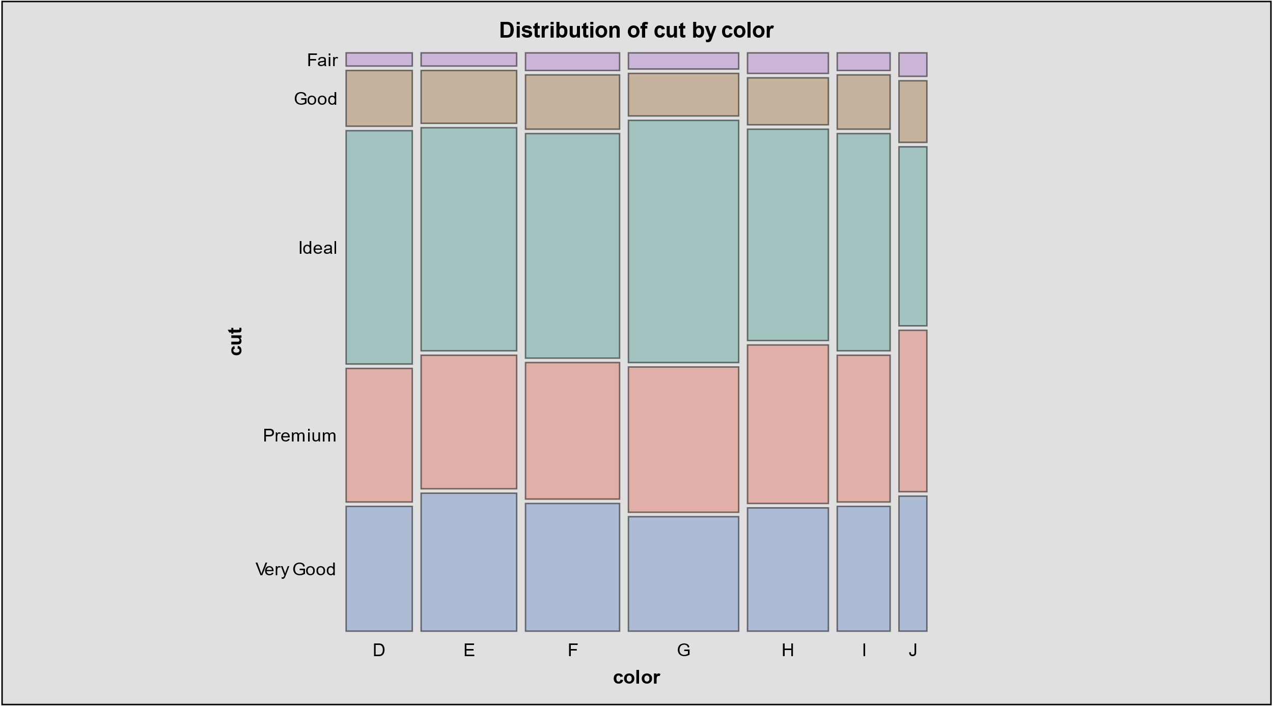
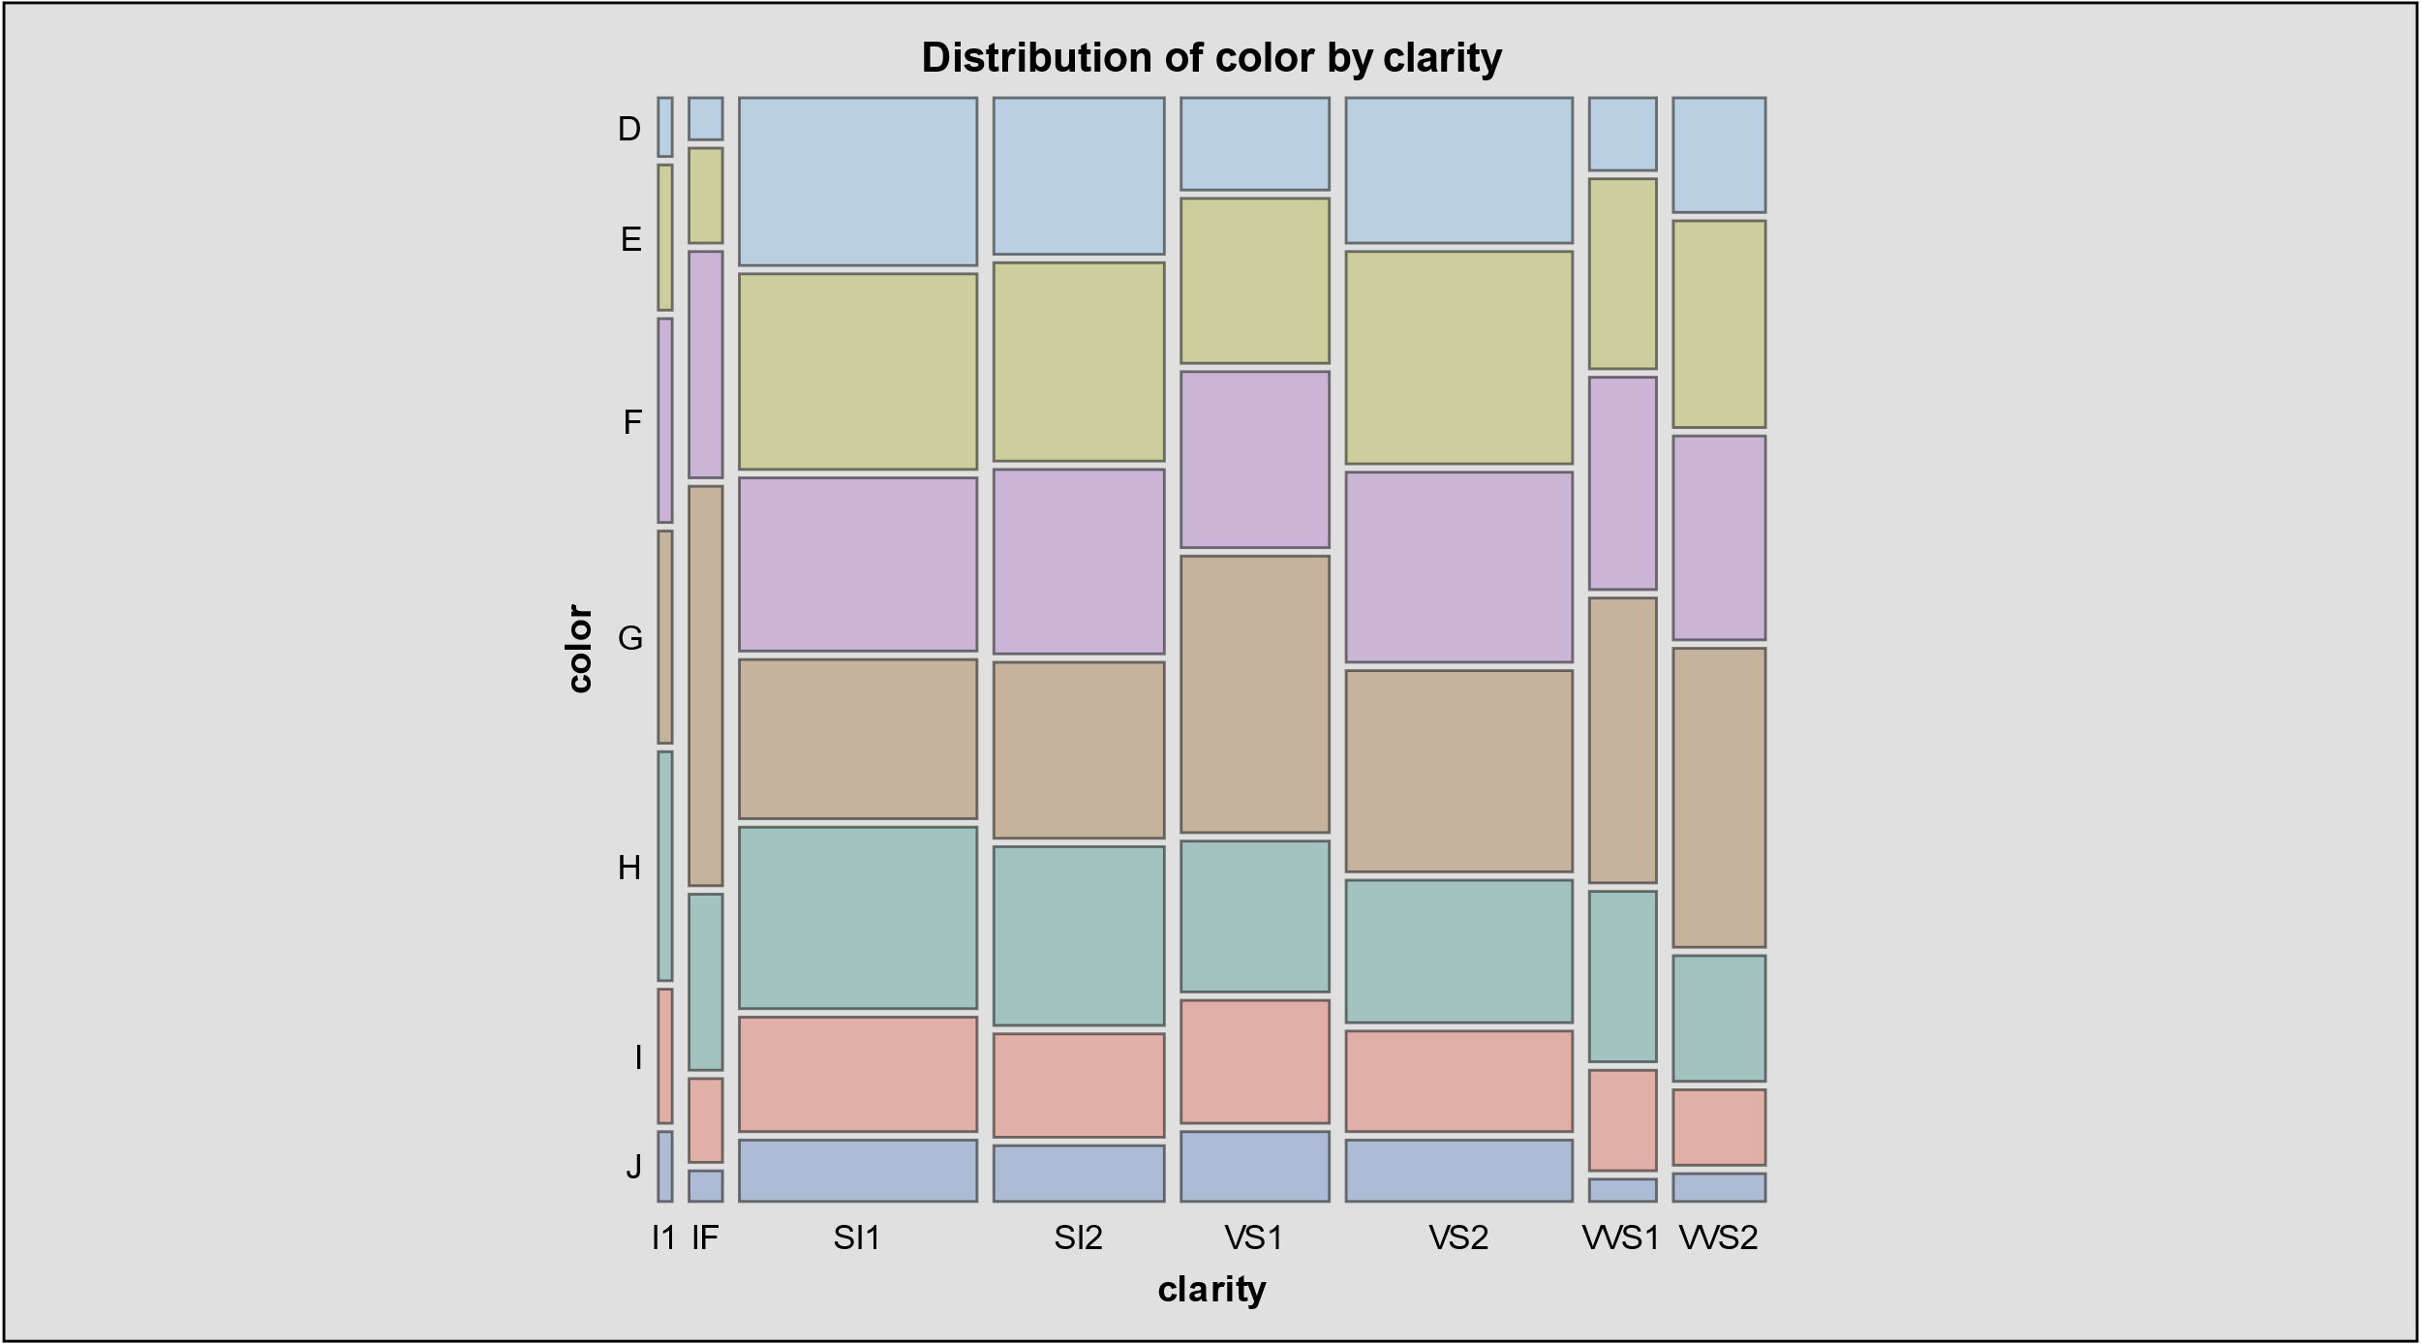
Pair Distribution
Big group of diamonds belong to
Cut Ideal – Color G
Cut Ideal _ Clarity VS2
Small group of diamonds belong to
Clarity I1 _ Color J
Clarity I1 _ Cut Vey Good

Slide 8
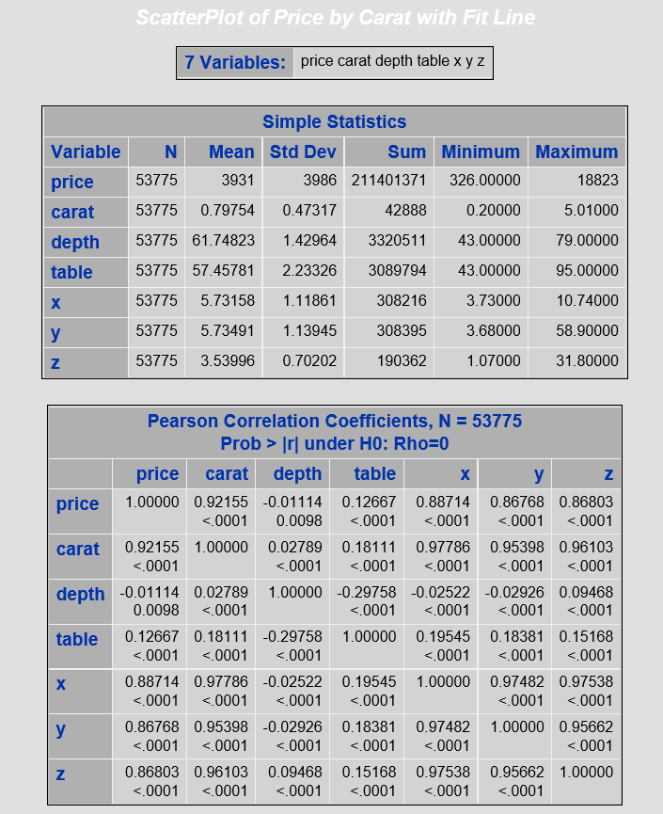
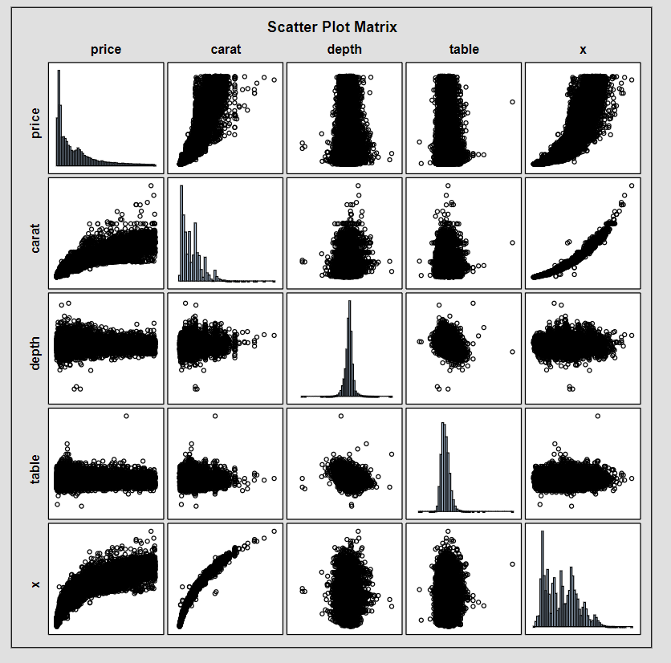
Diamonds Correlation

Slide 9
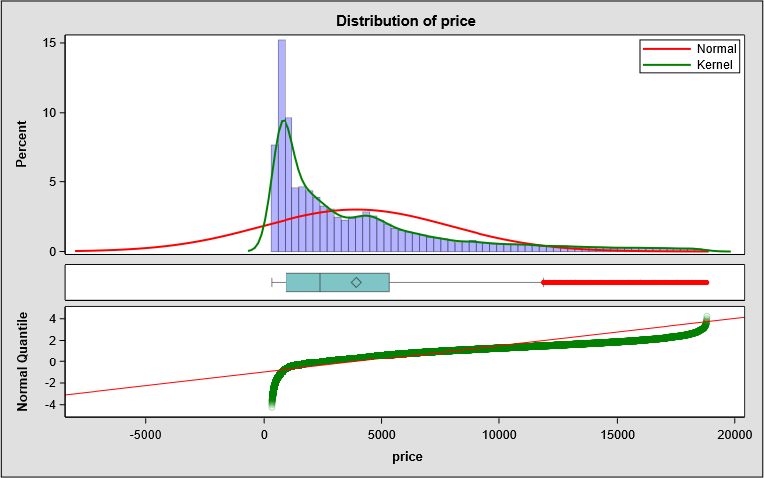
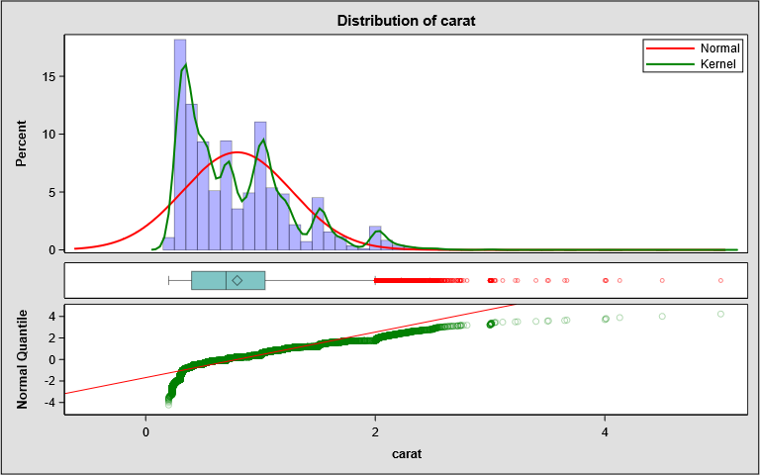
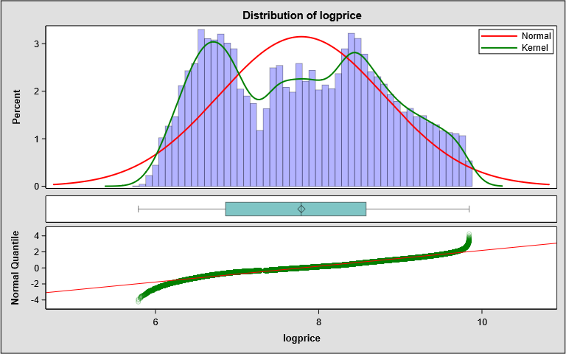
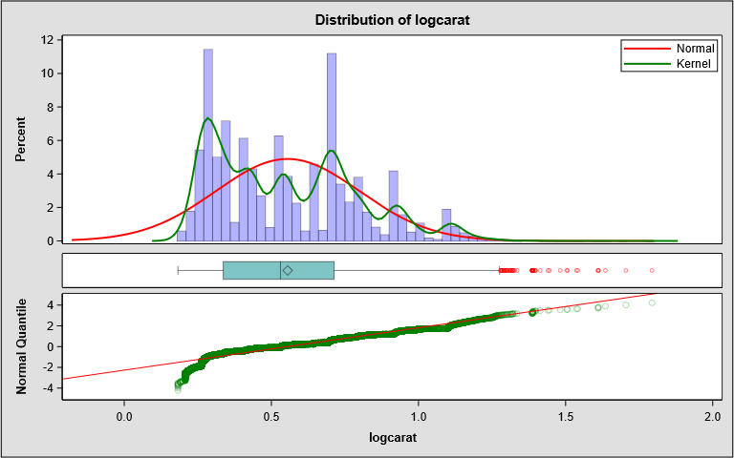
price
carat
logprice
logcarat

Slide 10
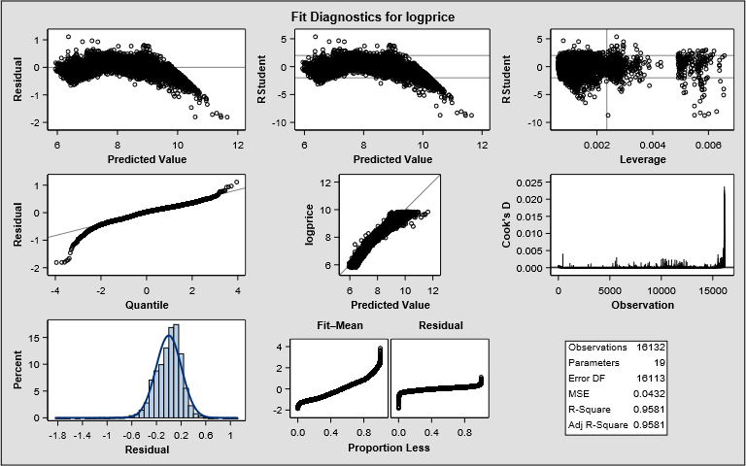
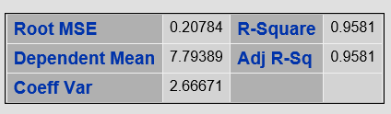
Linear Regression, Proc Reg

Slide 11
How much the company should pay for the same Cut and different range of Carat?
Proc reg
The average price for diamond dataset and predicted price for unpurchased diamonds.
The predicted price for small and mid weight diamond is lower than the dataset
We should NOT trust the predicted price for heavy diamonds!
Solution!?
Cut | Carat_Size(X) | predicted price | known-price
Fair | X<1 | 1601 | 2202
Fair | 1<X<2 | 5558 | 5274
Fair | 2<X<3 | 32054 | 11676
good | X<1 | 1439 | 1792
good | 1<X<2 | 6406 | 6345
good | 2<X<3 | 36481 | 14575
ideal | X<1 | 1202 | 1546
ideal | 1<X<2 | 6617 | 7898
ideal | 2<X<3 | 34948 | 15662
premium | X<1 | 1237 | 1597
premium | 1<X<2 | 6646 | 7233
premium | 2<X<3 | 35120 | 14907
verygood | cut<1 | 1314 | 1732
verygood | 1<X<2 | 6377 | 7270
verygood | 2<X<3 | 34422 | 15120
GLM
10567
14622
15489
14818
15546

Slide 12
How much the company should pay for Carat=1.5, Cut=Very Good, Color=VS2?
56 diamonds from the dataset has the following parameters
Carat=1.5, Cut=Very Good, Color=VS2
the average price is 11605.
96 diamonds from the dataset has the following parameters
1.5<Carat<=1.55, Cut=Very Good, Color=VS2
the average price is 11604.
Predicted price for the above parameters:
carat | cut | color | clarity | predicted_price
1.5 | Very Good | D | VS2 | 10805.4
1.5 | Very Good | J | VS2 | 10805.4
1.51 | Very Good | E | VS2 | 10112.04
1.51 | Very Good | G | VS2 | 8304.48
1.52 | Very Good | F | VS2 | 9523.83
1.52 | Very Good | G | VS2 | 8452.59

Slide 13
What is the final bid?
Our model recommends $12,990,108 for 3000 diamonds
What is the confidence level to bid this number?

Slide 14
Thank you

